Slide 1

San Diego Ocean Water Quality
DSE241 Data Viz Final Project
Alejandro Hohmann

Slide 2

Hypothesis: Rain events lead to increase in bacteria in San Diego’s ocean shore water
Runoff
Sewer overflow
Rain sweeps the streets and carries trash to the ocean
San Diego and Tijuana share a “boundary” but not sewage standards
San Diego Ocean Water Quality

Slide 3
Water Quality and Precipitation Data
San Diego’s Ocean Monitoring Program (OMP)
sample_id | station_id | sample_date_time | parameter | value
2001018683 | S11 | 2020-01-01 | entero | 220
2001018683 | S11 | 2020-01-01 | salinity | 33.409
2001029022 | C7 | 2022-12-29 | fecal | 2
2001029022 | C7 | 2022-12-29 | temp | 12.18C
15,000 samples | 104 sites | 2 years* | 10 measures | 8 scales
*30+ years of data available
National Oceanic & Atmospheric Administration
Geospatial Precipitation Data with corresponding latitude/longitude & date-time

Slide 4
BUSINESS OPPORTUNITIES ARE LIKE BUSES. THERE'S ALWAYS ANOTHER ONE COMING.
For Professional and Recreational Users
City Professionals who must prepare for bacterial blooms
Biologists who want to understand interaction with wildlife
Surfers who want to know if a certain amount of rain (actual or forecast) poses a bacterial threat
“
”
- Richard Branson
San Diego Ocean Water Quality

Slide 5
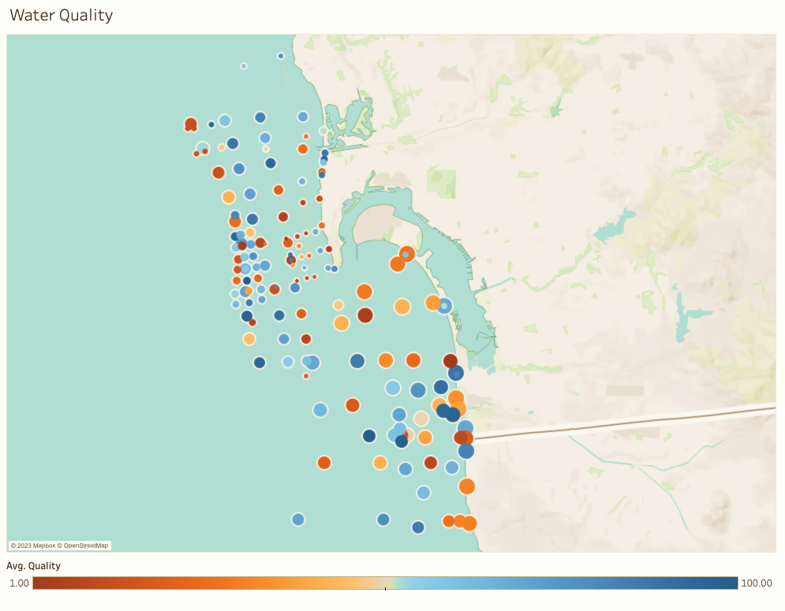
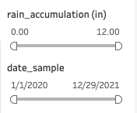
Mockup
Dynamic dashboard that demonstrates measurement levels at different rain accumulations (slider) and dates (slider)
User can toggle between 10 measurements and zoom/navigate to different areas
Built with Python on top of Plotly/Dash and GeoPandas
idiom: heat map
mockup

Slide 6
IMPLEMENTATION
San Diego Ocean Water Quality

Slide 7
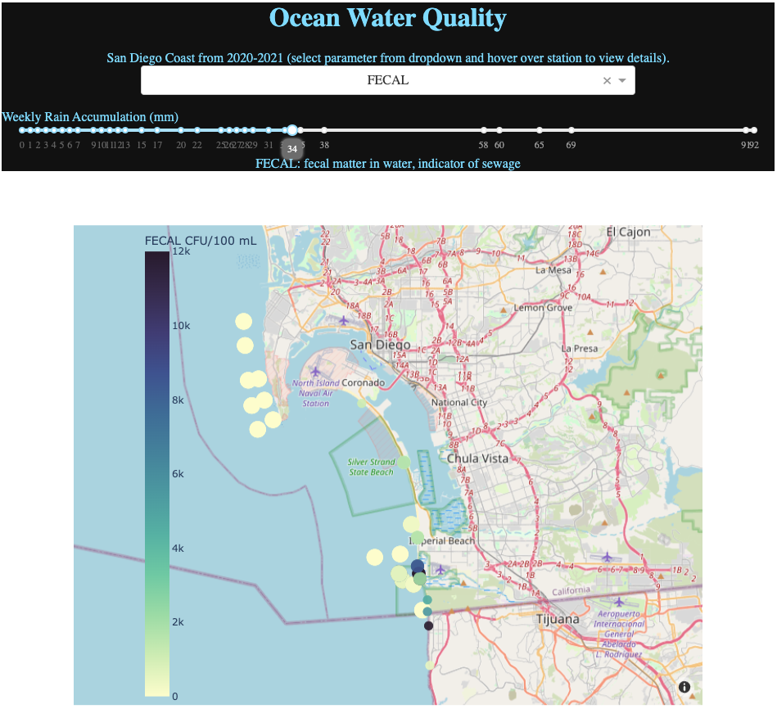
Implementation
Dynamic dashboard that demonstrates measurement levels at different rain accumulations (slider)
User can toggle between 10 measurements and zoom/navigate to different areas
Built with Python on top of Plotly/Dash

Slide 8
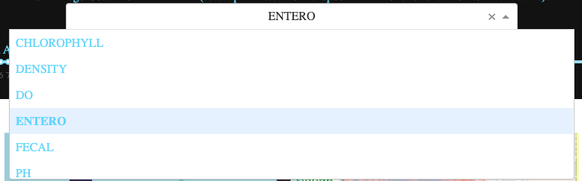
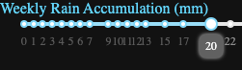
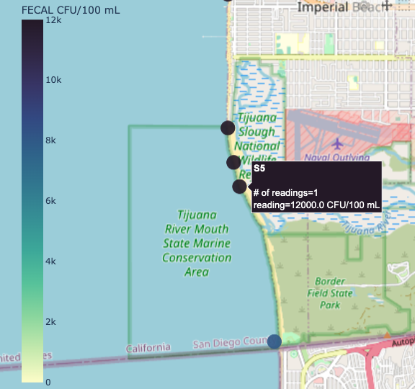
Idioms & Channels
Scatter Chart (geospatial)
Drop down menu to select parameter
Slider to select rain accumulation
Color channel: measurement scale
Size channel: # of readings at site
Text channel
Exact measurement within tooltip when hovering over point station

Slide 9
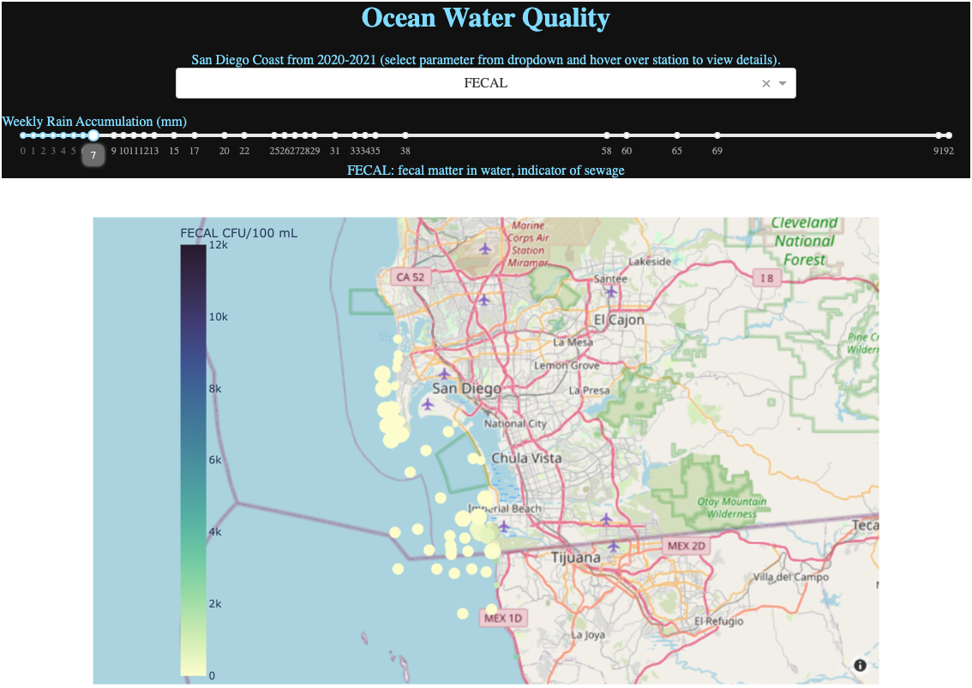
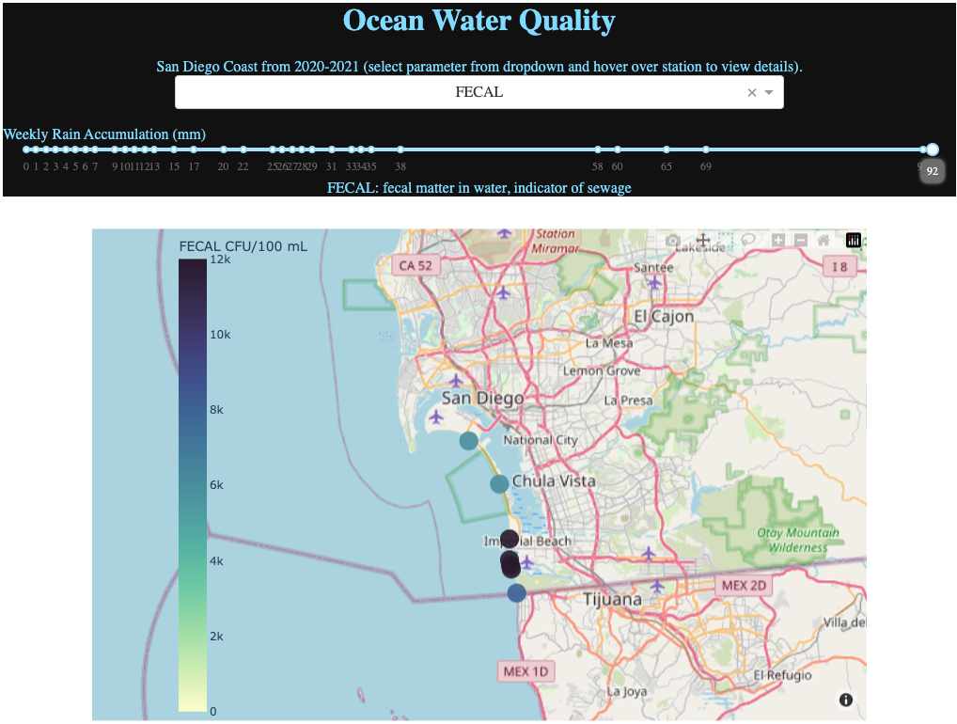
QUESTION: does rain increase bacteria blooms? ANSWER: Yes! Especially close to border
Example Comparison
Fecal matter in water;
7mm rain vs 92 mm rain
San Diego Ocean Water Quality

Slide 10




Contact
Alejandro Hohmann
ahohmann@ucsd.edu
github.com/gojandrooo
San Diego Ocean Water Quality

Slide 11
San Diego Ocean Water Quality

